Slide 1
Comprehensive Digital Marketing Project Work

Slide 2
THE TEAM MEMBERS ARE
MD ARFANA – 720131605227 ( TEAM LEADER)
MANDE RITIKA – 720131605223
KOTTAPALLI PAVITRA – 720131605221
KATIKITHALA SHAKEENA – 720131605219 MARRAPU MOULI MANOHAR – 720131605222

Slide 3

PART-1 : Brand study, Competitor Analysis & Buyer’s/Audience’s Persona Missions/Values :-To enhance the wealth generations capability of the enterprise in a globalization environment delivering superior and sustainable stake holder value Brand Color :- Red, Gold and Yellow logo :- USP :- The USP of sunfeast is to satisfy their needs, sunfeast offers a wide range of products such as buscuits, cakes, rusk & chocolates. Their unique selling propositionis that they offer taste and nutrition in every bite. Tagline :- Delight hungary stomachs ! Anytime, anywhere.

Slide 4
PART-1 : Brand study, Competitor Analysis & Buyer’s/Audience’s Persona Research Brand Identity :- Study the brand’s mission, values, visions and unique selling proposition (UPSs). Quality and Taste: Sunfeast often emphasizes the quality and taste of its products. Their messaging focuses on using high-quality ingredients and maintaining strict quality standards to deliver delicious and satisfying biscuits and snacks to consumers. Variety and Innovation: Sunfeast's brand messaging has highlighted the wide range of products they offer, showcasing their commitment to innovation and continuously introducing new and exciting flavors and variants to cater to diverse consumer preferences. Nostalgia and Trust: Sunfeast has built a sense of nostalgia and trust by positioning itself as a brand that has been part of consumers' lives for many years. They often evoke feelings of nostalgia, family bonding, and traditions in their messaging. Health and Nutrition: In recent years, as consumer preferences shifted towards healthier options, Sunfeast has adapted its messaging to highlight healthier ingredients, reduced sugar content, and other nutritional benefits of their products.

Slide 5
Advertising and Promotions: Sunfeast has employed various marketing channels and celebrity endorsements to reach a broader audience. Their advertisements often focus on happiness, celebrations, and sharing joyful moments with loved ones over their products. Social Initiatives: Sunfeast has also been involved in various social initiatives, which they sometimes incorporate into their brand messaging to showcase their commitment to corporate social responsibility.Regional and Cultural Relevance: Sunfeast has a strong presence in India and other countries, and they often incorporate regional and cultural elements into their messaging to connect with local consumers.

Slide 6
PART-1 : Brand study, Competitor Analysis & Buyer’s/Audience’s Persona
Competitor Analysis : Select three competitor‘s operations in the same industry or
niche.
Competitor 1 (Oreo Biscuits) :www.bigbasket.com
USP : unique taste and texture.
Communication : it uses a wide range of advertisements and campaigns.
Competitor 2 (Parle G) : www.parleproducts.com
USP : one of India’s most trusted, affordable and sold food brand.
Communication : it uses wide variety of channels for communication both analog and digital.
Competitor 3 (Britannia Burbon Biscuits) : www.britannica.com
USP : thick, rich and delicious chocolate packed between two crunchy chocolate biscuits.
Communications : it uses blogs and targeted ads on its main platform to increase sales.

Slide 7

Buyer’s /Audience’s Persona : Clearly define the target audience for the chosen brand. Consider demographics, phsycographics, behavior’s and interests.
Sunfeast :
18-55
Women
Yes
Married/unmarried
Metro cities like Mumbai, Delhi etc,.
Tier 2 and Tier 3 cities
Not remote villages
3,00,000 per annum – 20,00,000 per annum
At least 10+2
Ad, youtube , Instagram, community platforms like quora , facebook groups, TV
Social status, personal appearance, long lasting, price ingredients, brand, reviews, comparision, vegan and cruelty free
Incomplete ingredients list, quality
Buyer Persona Consideration‘s
What are their professional and career goals?
How does your product fit into their goals?
How can you help solve challenges and meet goals?
Age Range
Gender
Children
Martial Status
Location
Income
Education
Demographic
Goals and challenge
How do they get their information?
How do their communicate?
What social media channels are they on?
Do their prefer videos (or) webinars?
Do they attend conferences?
Information Gathering
Job title / role
Career path
Company size
Industry
What types of tools do they use regularly.
Professional information

Slide 8
Part 2 : SEO & Keyboard Research
Only doing SEO keyword research once , Not bothering to update and expand their SEO keyword list, or Targeting keywords that are too popular, meaning they’re way too competitive . Basically, SEO keyword research should be an ongoing and ever-evolving part of your job as a marketer. Old keywords need to be reevaluated periodically, and high-volume, competitive keywords (or “head” keywords, as opposed to long-tailed keywords) can often be usefully replaced or augmented with longer, more specific phrases designed not to bring in just any visitor but exactly the right visitors.
SEO Audit: Do an SEO audit of the brands website
Keyword Research : Define Research Objectives, Brainstorm Seed Ketwords, Utilize Keyword Research Tools (SEMrush or Moz Keyword Explorer), Analyze Competitor Keywords, Long-tail Keyword Exploration (specific, longer phrases) that align with the research objectives and have lower competition but higher conversion potential.
On page Optimization: Meta Tag optimization & content optimization
Reflect on the process of conducting keyword research and the SEO recommendations provided.
Document the challenges faced during the research and analysis phase, as well as the key insights gained from the keyword research process.

Slide 9
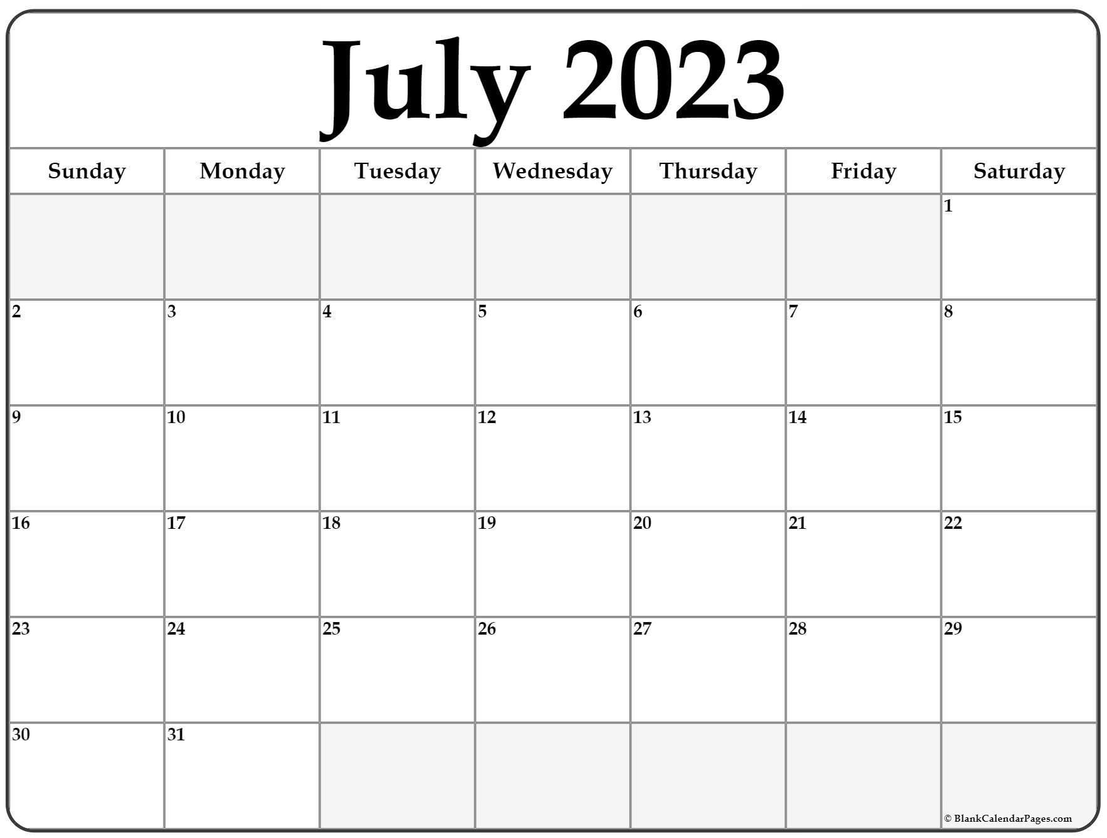
Part 3: Content Ideas and Marketing Strategies
Content Idea Generations & Strategy:
Create a content calendar for the remaining month of July by brainstorming content themes, exploring various formats like blog posts, videos, infographics, podcasts, and interactive quizzes, and scheduling publication dates mainly on Facebook & Instagram.
And include the strategy, aim and the idea behind these posts and story.
Facebook ads
Group meeting
Instagram story
twitter tweets
Blog update
Muharram

Slide 10
Part 3: Content Ideas and Marketing Strategies
Marketing Strategy of Sunfeast analyzes the brand with the marketing mix framework which covers the 4Ps (Product, Price, Place, Promotion). These business strategies, based on Sunfeast marketing mix, help the brand succeed in the market. Let us start the Sunfeast Marketing Strategy & Mix to understand its product, pricing, advertising & distribution strategies.
Sunfeast’s biscuits segment product offerings in its marketing mix can be divided broadly into four categories:
• Health Bites
• Light ‘n’ Fun
• Cream Delight
• Cookies
It also has a super-premium range of gourmet cookie offerings such as HiFi Cookies, Delishus and Mom’s Magic. Sunfeast also has a sub-brand called Yippie which offers a variety of products in the instant noodles and pasta segment such as- Magic Masala Noodles, Mood Masala Noodles, Classic Masala Noodles.

Slide 11
Part 4: Content Creation and Curation (Post creations, Designs/Video Editing, Ad Campaigns over Social Media and Email Ideation and Creation)
Format 1 Blog article of sunfeast
Aim: Boost seo & provide information about a cobain now product
Idea : Sunfeast has launched super millet & is made up of jowor choco-chip cookies with no added maida
Date : 12-05-2023
Topics : these cookies contain protein, fiber and iron and taste

Slide 12
Format 2 : Video
Aim : to promote newly launched super millet cookies
Date : 14 May-2023
Idea: sunfeast new has new launched the super millet Cookies Coated with the choce chips tauty and delicious with good fiber
Topic: These Cookies are rich in protein, fibre & incon and contain good taste

Slide 13
Format 3 : Creative
Aim : Brand awareness and reach
Date : 14-05-2023
Idea : To create new and healthy products
Topics : Healthy and tasty biscuits and cookies

Slide 14
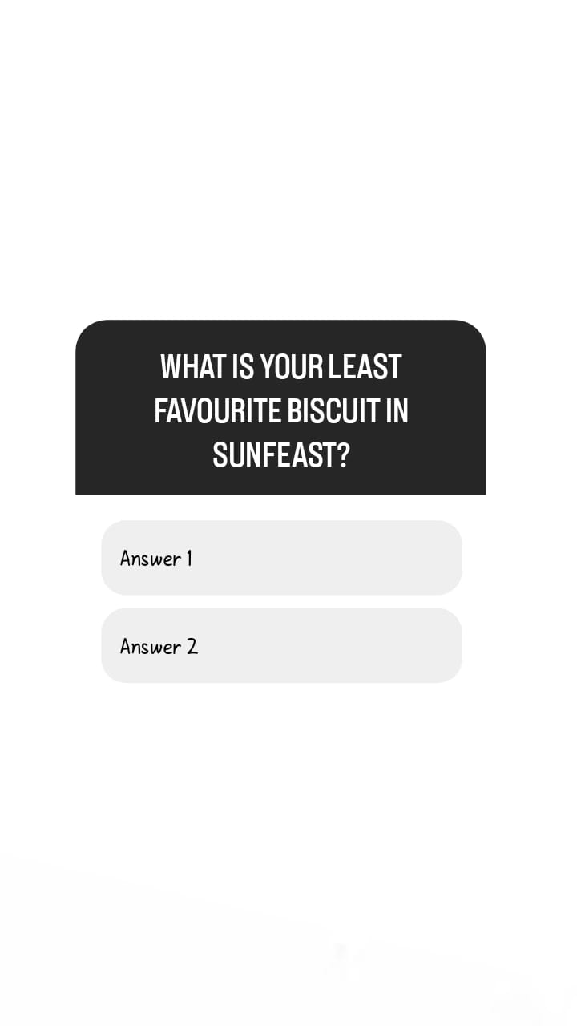

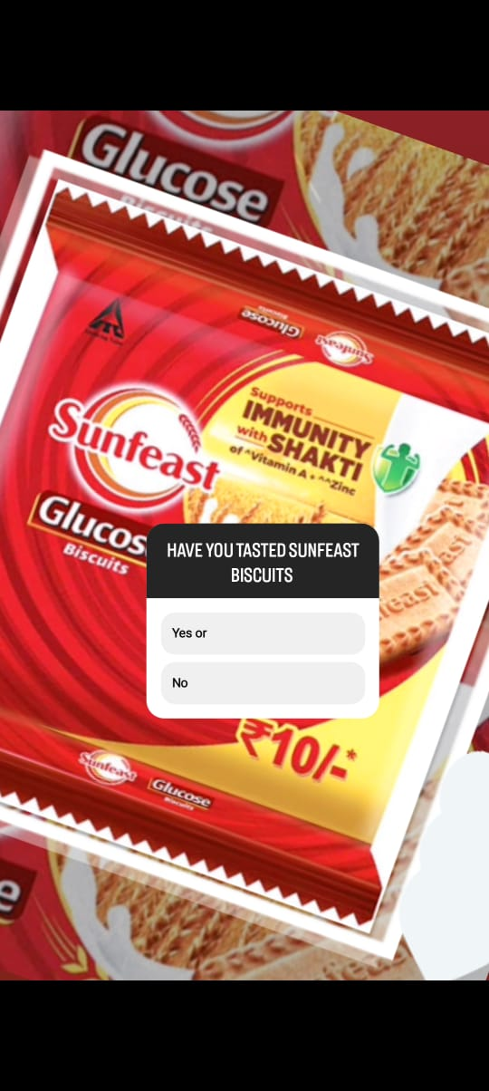
Part 4 : Content Creation and Curation (Post creations, Designs/Video Editing, Ad Campaigns over Social Media and Email Ideation and Creation)
Instagram story

Slide 15

Part 4 : Content Creation and Curation (Post creations, Designs/Video Editing, Ad Campaigns over Social Media and Email Ideation and Creation)
Design/Video Editing

Slide 16
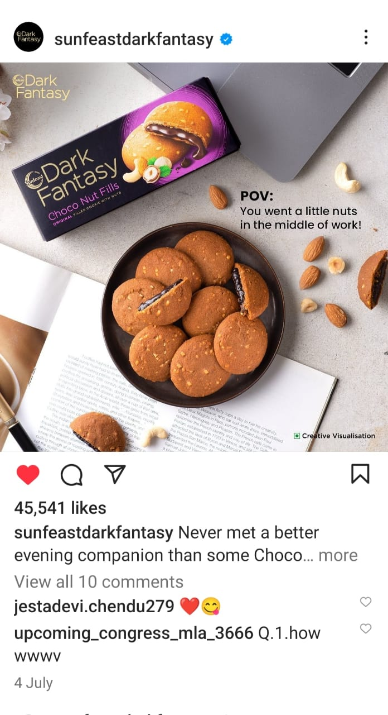
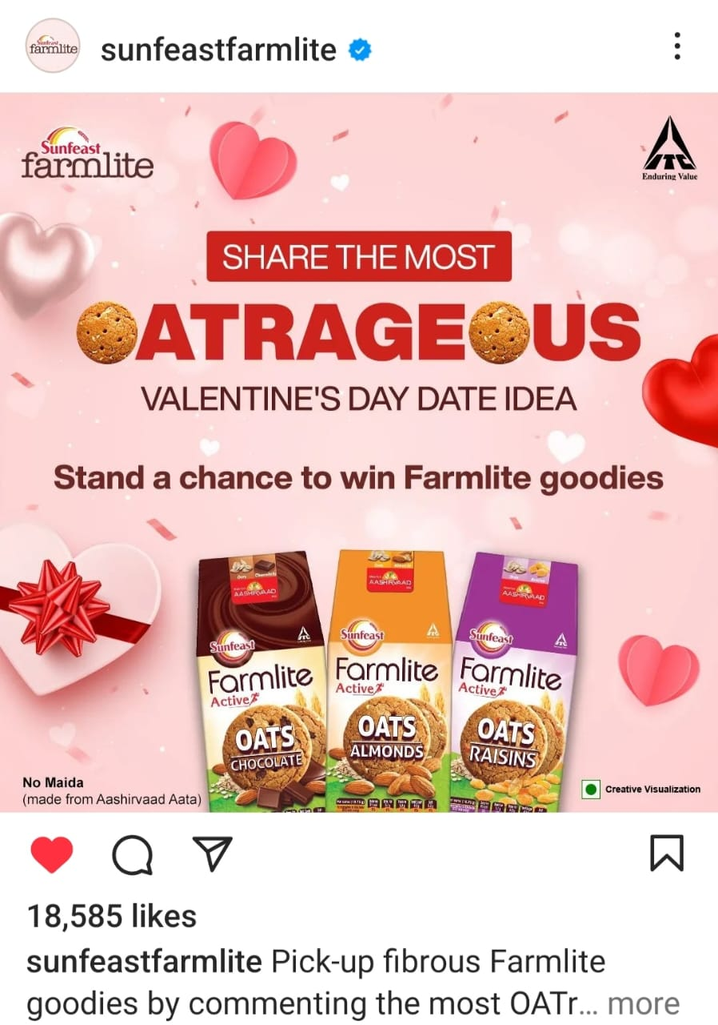
Part 4 : Content Creation and Curation (Post creations, Designs/Video Editing, Ad Campaigns over Social Media and Email Ideation and Creation)
Social Media Ad campaigns

Slide 17
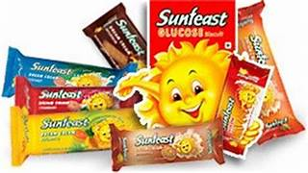


Email AD Campaign 1 – Brand Awareness
To :- kumar@gmail.com
Subject: we, at sunfest wellness company, always belived in bringing safe, efficacious and affordable products to our customers have
Key highlights of our brand
Natural ingredient & sunfest products are using natural ingredient chemical composition. I without any
Environmentally conscious: our commitment to be sustainability drives us to reduces the and support eco-friendly practices
safety and Quality!- Sunfest use high quality products and maintain hygiene in t while preparing products and ensure safe and effective products
Global presences Dunfest producks are available in various countries and we Continue to expand our steach to help more people world wide
Proven formula; own produck are developed and combine traditional Knowledge with misdern science for the best result

Slide 18



Email AD Campaign 2 – Lead generation
To: reddy@gmail.com
Subject : unlock the power of nature with the sunfest products our lead, constitution campaign
I hope the emails finds you Well. My name in [Arfana] and i represent sunfeast product a brand that stands for the nutritional goodness of nature healthy and hygiene food you
Today : I am excited to introduce to the to our lead generation campagin By participating in our lead generationCampagin you will
Exclusive offers : Accessive access to excusive exclusive offers for partipation I had generation campagion
Be part of a community : To all the N participation of lead generation Campagion will exclusively become a part of the Sunfest community
Early access : Be among the first to Know about, out sunfest product launches and up dates an

Slide 19
Challenges faced and lessons learned during project
As we are new to the project we have proper guide about the project during the project the challenges faced that are the project have a strategic, innovative focus as the result, we have to often deal with new, leading edges and the technologies these project has more risks and much more difficult to estimate the accurately. And the lessons learned during the project through these project we have learn the exprience as we gain by the project and we have learned how edit the contents and study of the project, editing the video and we have learn about the marketing strategies and how to Create the ads and how to analyze the matter

